Slide 1
Special Topic - Preliminary Evaluation Presentation
Mini-Project
English Sentence Evaluator
Domain : Natural Language Processing
Presented By GUIDE
K R Anushree, 1PI11IS127 Prof Viraj Kumar

Slide 2
Contents
Problem Statement
Motivation
Parsing in NLP
Libraries Available
Architecture of Library for solving the problem
Future Enhancements

Slide 3
Problem Statement
To develop an algorithm which evaluates an English Sentence for grammatical errors and semantics, when given an English Sentence and a list of expected words as input, and a preset threshold value of probability.

Slide 4
Motivation
To learn about parsing concepts in the context of Natural Language Processing.
Develop a “grammar evaluator” library for English.
Scope of the field.

Slide 5
Parsing in Natural Language Processing
A simple CFG.
S -> NP VP PP -> P NP NP -> Det N | Det N PP | 'I' VP -> V NP | VP PP
Det -> 'an' | 'my' N -> 'elephant' | 'pajamas' V -> 'shot'
P -> 'in'

Slide 6
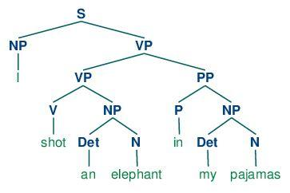
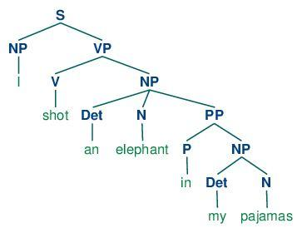
Ubiquitous Ambiguity

Slide 7
Resolving the Ambiguity
Need a way to identify the tree that makes most sense out of the obtained Parse Trees
Solution :-
Select a tree - most probable to occur.
=> Need to assign probabilities to the grammar and evaluate final probability of Tree.

Slide 8
Probabilistic Context Free Grammar
S -> NP VP [1.0] VP -> TV NP [0.4] VP -> IV [0.3] VP -> DatV NP NP [0.3] TV -> 'saw' [1.0] IV -> 'ate' [1.0] DatV -> 'gave' [1.0] NP -> 'telescopes' [0.8] NP -> 'Jack' [0.2]
for S, there is only one production, with a probability of 1.0; for VP, 0.4+0.3+0.3=1.0; and for NP, 0.8+0.2=1.0.

Slide 9
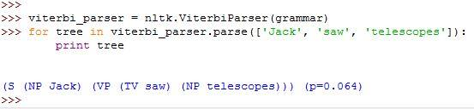
PCFG Output - nltk library

Slide 10
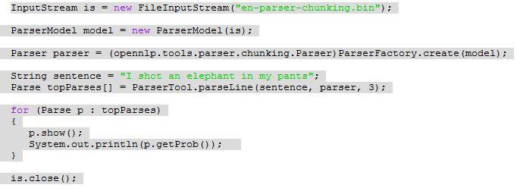
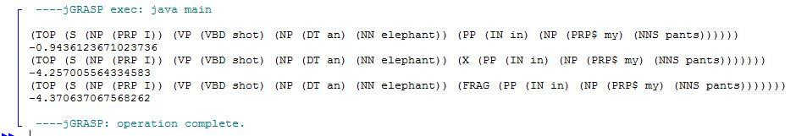
PCFG parse for Ambiguous Sentence

Slide 11
Problems with PCFG
Doesn’t give weights to words. Some of the words in sentence dominate and thus determine the meaning and can be helpful in removing the ambiguity.
Repetitive occurrence of certain derivation.

Slide 12
Lexicalized PCFG
Usage of a ‘head’ word for each rule.
Based on the head word associated with the root node S - disambiguation is done.

Slide 13
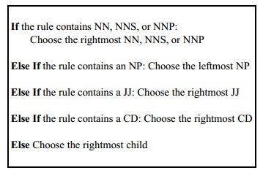
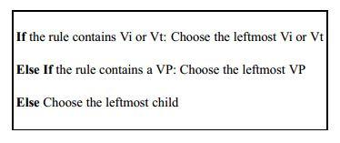
Associating Head Words
NP
VP

Slide 14
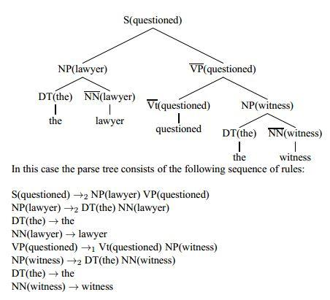
Example of Lexicalized PCFG

Slide 15
Available Libraries and Implementation
Python
nltk
provides functions for different kinds of parsing - shift reduce, bottom up, pcfg, chart parser, feature parse
can provide our own grammar or use tree bank
Disadvantage :- too simplistic for real time usage

Slide 16
Available Libraries and Implementation
JAVA
OpenNLP Apache
Feature :- uses PCFG for computation
Can obtain more than one parse tree along with probability value.
Contains well trained models
Disadvantage :- Parses even grammatically wrong sentence.
Doesn’t emphasize on context.
Model files and jar files huge (~80 MB)
Not well documented

Slide 17
Available Libraries and Implementation
JAVA
Stanford CoreNLP
Features :- Uses a combination of Lexicalized PCFG and PCFG
Provides context based parsing option
Disadvantage :- Huge JAR files and Model Files
Corrupt model files
Too many features in one library - may not required for certain kinds of application
Generates parse trees for Grammatically Incorrect statements.

Slide 18
Solving the Problem Statement
Steps :-
Threshold Setting :-
Run the parser for the most correct sentence grammatically for a given bag of words.
Obtain the probability.
Now run the parser with sentences which are also grammatically correct and obtain probability.
Repeat above step for incorrect sentences.
Set a threshold value for the bag of words such that it accepts maximum possible correct sentences.

Slide 19
Solving the Problem Statements
Steps
Evaluate input sentence
check for the presence of bag of words
Run the parser with the sentence and obtain probability
If probability >= threshold => assign high score
else assign low score.

Slide 20
Usefulness of the algorithm - a scenario
Server
Input Sentence, Bag of words, threshold
A Mobile App for kids to check grammatical correctness
Algorithm
implemented as
Library
Score of the sentence

Slide 21
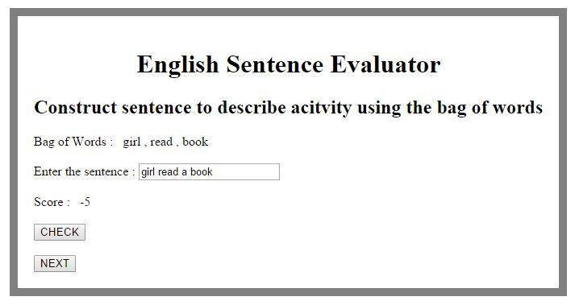
Output Screen-shots

Slide 22
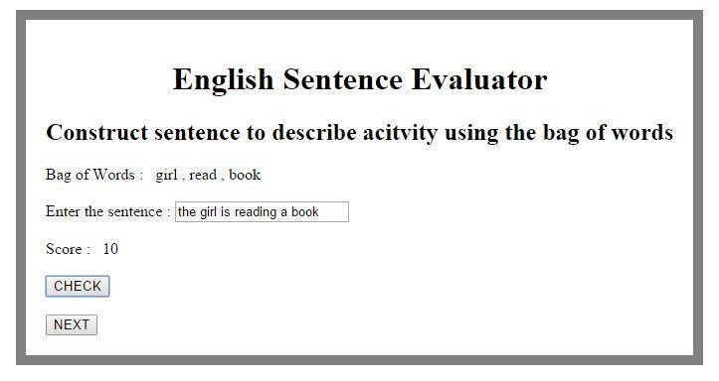
Output Screen-shots

Slide 23
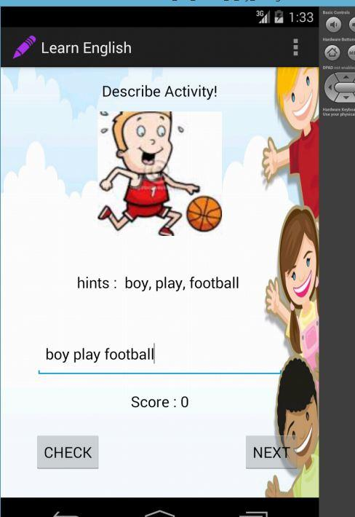
Output Screen-shots

Slide 24
Problems with Algorithm and Scope for Future Enhancement
Not 100% accurate
Computation time is more
Too primitive, cannot handle complex structures well
Context / Semantics not well handled
Use Machine Learning technique to self learn the threshold

Slide 25
References
[1] http://www.nltk.org/book/ch08.html
[2] http://www.nltk.org/howto/parse.html
[3]Lexicalized Probabilistic Context-Free Grammars, Michael Collins <LECTURE NOTES>
[4] http://www.cs.columbia.edu/~mcollins/courses/nlp2011/notes/lexpcfgs.pdf

Slide 26
Thank you.

